Slide 1
Intro to HR and
Navy Recruiting
Tuesday, 06DEC22
Notes:
Officer slide use, shuffle or delete to support your visual content.

Slide 2
WELCOME!
CDR Keith Bushey, Commanding Officer, NTAG SW
Today’s Presenters:
HR Community Overview CDR Keith Bushey, 1207
Force Management Track LCDR Nikita Taylor, 1200
Force Resources & Reqs Track LCDR Nikita Taylor, 1200
Force Development Track LCDR Jamie Evans, 1200
NTAG SW Overview LCDR Twyla Arbuckle, 1200
Direct Commissioning (Reserve Process) LTJG Marcia Villavicencio, 6415
Values and Key Takeaways LCDR Twyla Arbuckle, 1200
Notes:
Multiply and manipulate this slide to fit all your text, video and etc. content

Slide 3
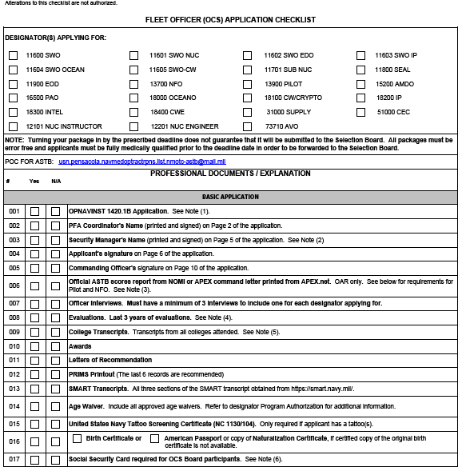
Fleet Officer Application Checklist
REVISION
SEP 2021
No Blank Pages in your package!
Notes:
Multiply and manipulate this slide to fit all your text, video and etc. content

Slide 4
Notes from OCM & Mr. Celestin
Application and Medical docs must be less than 10MB.
USNR Sailors, ALL "HM" and Nuclear sailors must have an approved conditional release from the Enlisted Community Managers.
OAR, Letters of Rec, PRIMS, DD 2807-1 & 2807-2 and SMART Transcripts are not required.
High School transcripts are not required if you have a bachelor degree that was obtain from a college / university in the United States.
Official transcripts from ALL Colleges attended are required, showing conferred degrees; if transcripts are foreign, transcripts must be translated from an accredited U.S. Evaluation service on a 4.0 U.S. grade scale, provide all translated and original language transcripts with application submission.
In the PRT Block write COVID-19 and supply the last 6 PRT Cycle PRIMS Report and record the time for the planks in the block mark for sit-ups.
Request applicant contact Detailer if under orders to inform of intention to submit for OCS or within 90 days of current PRD to obtain PRD adjustment.
Board results may be released to BOL 2 - 10 weeks after the convening of the board.

Slide 5
Program Authorization 109
US Citizen
Age 21-42
HR-Focused Bachelor’s with a 2.2 GPA or higher
Fully Medically Ready and available for worldwide assignments
No Record of Disciplinary Actions (no convictions, or misdemeanors i.e. DUI/DWI) within 3 years
PFA (Run preferred)
Two O-6 or above HR Interview Appraisals
Warfare Qualification
ACTIVE DUTY ONLY, 12-months Time in Service
NO WAIVERS
If selected: OCS → Rank of Ensign (O-1E with qualifying records) → 8-year Service Obligation
Start Here:
https://www.mynavyhr.navy.mil/Career-Management/Community-Management/Officer/Active-OCM/Restricted-Line/Human-Resources/
Notes:
Multiply and manipulate this slide to fit all your text, video and etc. content

Slide 6
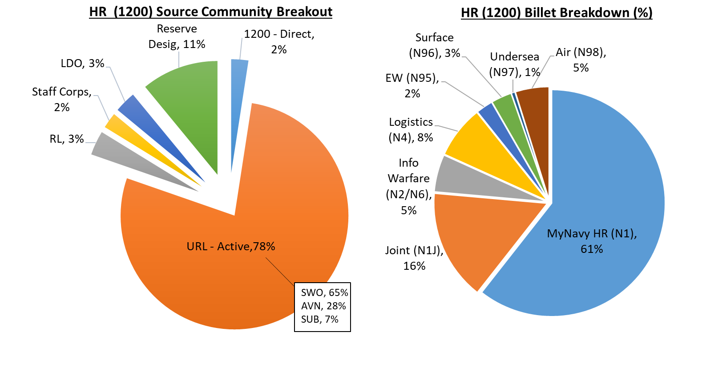
HR COMMUNITY OVERVIEW
AC Accession Sources (FY21):
Lateral Transfer (52%)
POCR (40%)
Indefinite Recall (8%)
AC % Warfare Qualified:
2017 (53%)
2022 (61%)
HR Community accesses its Officers from 31 different Navy designators
Notes:
(Comments written Left to Right, Top to Bottom)
- HR Community mission is to man the fleet and to support the MyNavy HR enterprise with world class HR service delivery.
HR Community AC (1200) is almost entirely dependent on “right-side” accessions via lateral transfer and Probationary Officer Continuation & Redesignation (POCR) boards for accessions.
The HR Community has both a TAR and SELRES component. Overall community composition is ~60% AD, 20% TAR, 20% SELRES.
The HR has a large billet footprint globally with a larger presence in NCR and Millington, with the RC also in Norfolk. AC HR billets are spread across Force Mgmt (35%), Force Dev (35%), and FR2 (19%).
The 1200 Community is sourced predominately from URL communities (78%) with Surface Warfare the most common designator amongst URLs and HR overall.
A large and increasing % of HR Officers are warfare qualified and understand fleet requirements.
61% of the HR billet base is primarily within RS1 (MPT&E) but has representation across all Joint and Navy N-codes.
Similar graphics are available for the 1205/1207 designators in the backup slides.

Slide 7
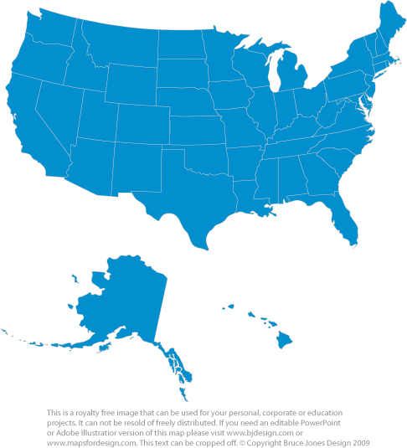
WORLDWIDE PRESENCE (AC, TAR, SELRES)
Northwest – 7/5/2
Northeast/Mid-Atlantic – 171/91/74
BSO | Billet Types
CHNAVPERS | Manpower Plan, Personnel Plans & Policy, Recruiting, Reserve Support, Budget M&P, Training, CO, XO, IT Mgt, Ops Analysis, MNCC
CFFC | Manpower/Personnel Plan (N1X), Training Afloat, Force Integration, ECRC XO, Mobilization Det CO/XO
COMPACFLT | Manpower/Planning (N1X), Afloat Training, Fleet Distribution
OSD/JCS | Director, Chief, Manpower Plans, Joint Requirements, Deputy Director Training, Director Planning & Programming
NETC | Training, CO, XO, Manpower Plans, NR OTC Newport OIC
CNRFC | Manpower Plans/Mgt, Financial Mgt, IT Systems Mgt
AFRICOM/ SOUTHCOM/ STRATCOM/ EUCOM/ SOCOM/ NORTHCOM | FTS Strength Mgt, Chief Navy & MC Reserves, Chief Navy & MC, Chief DSP, Personnel Plans, Chief HR Div, Reserve Affairs, Personnel P&P, ADP Plans
CNIC | Manpower/Personnel Plans, OSO
Midwest – 133/41/51
Southwest – 78/25/24
Southeast – 73/19/35
Europe/Middle East/Africa/Asia/Guam – 32/0/5
Hawaii – 14/2/3
~40% of billets reside in the Capital Region and Millington
Source: ANF (EOM HR Inventory JAN 2022)

Slide 8
HR CAREER PROGRESSION
HR HQ / COMPETENCY EXPERIENCE /
JOINT / BROADENING TOUR
DIVO / DH (SOURCE COMMUNITY OR HR) / STAFF TOURS /
GRAD ED / INITIAL EXPERIENCE TOUR / BROADENING TOUR
HR HQ / COMPETENCY EXPERIENCE /
JOINT / BROADENING TOUR
CDR LEADERSHIP TOUR
MAJ CMD / TYCOM, COCOM N1
CAPT PINNACLE
LCDR LEADERSHIP TOUR
HR HQ / EXPERTISE / JOINT
HR HQ / UTILIZATION
Competency Assignment/Career Track Designation
O6 PINNACLE SLATE
POCR & Lateral Transfer Gains
0 2 4 6 8 10 12 14 16 18 20 22 24 26 28
O4 SB
O5 SB
O6 SB
Typical Billets/Quals
HR Leadership Admin Screen Boards
NOVICE
INTERMEDIATE
ADVANCED
EXPERT
PINNACLE
Force Development
Graduate Education
Department Heads
Action Officers
Small Detachment OICs
Small Unit Commanding Officers
Executive Officers
Officers in Charge
Afloat TRAINOs
Branch Heads
Commanding Officers
Large unit/system Executive Officers
Deputy Commanders
Division Directors
Major Commanders
Directors
Division Directors
Chiefs of Staff
Force Rqmts / Resourcing
Graduate Education
Department Heads
Action Officers
Analysts
Branch Heads
Lead Analysts
Large unit/system Executive Officers
Section Heads
Deputy Directors
Program Leads
Major Commander
Program Managers
Deputies
ES Deputy
PMC DIVDIR
Force Management
Graduate Education
Department Heads
Action Officers
Small Detachment OICs
Small Unit Commanding Officers
Executive Officers
Officers in Charge
Branch Heads
Commanding Officers
Large Detachment OICs
N1 / J1 Division Directors
N1 / J1 Deputies
Large Branch Heads
Major Commander
Directors
Division Directors
N1 / J1
PMC DIVDIR
Fleet N1Bs
HR Masters, JPME I, HR Introductory Course, HR-Valued Professional Certification
JPME II, JQO, HR Advanced Course, HR-Valued Professional Recertification, SME Development
VALUED BILLET DESCRIPTIONS
CAREER TRACK AQDS
VALUED SUBSPECIALTIES
Broadening Tours: Career broadening outside of MyNavy HR (e.g., Flag Aide, EA, DEA, Tour with Industry, Joint, In-Residence Grad Ed) Experience Tours: Expertise development via Fleet/Staff Action Officer tours within MyNavyHR (e.g., Divo, DH, OIC/Staff, Detailer) HR Headquarters Tours: Represent challenging HR staff assignments at SECNAV/ASN, CNP/OPNAV, DCNP/NPC commands Leadership Tours: Board screened command positions at LCDR - CAPT Milestone Tours: Most difficult non-command tours filled by highly skilled screened officers. (e.g., Finance Mgmt/OA, N1/J1 Expanded Opportunities) Pinnacle Billets: Most challenging senior O6 HR billets – must be well-rounded and fully qualified to hold (e.g., N10B, ES Deputy, USFFC N1B, or PACFLT N1B). Sea Tours: Deployable HR assignments within type 2 or type 4 commands
Force Development (FD)
Force Management (FM)
Force Rqmt/Resourcing (FR2)
31XX | Financial Management | 3150 | Training & Education
3130 | Manpower Systems Analysis | 321X | Operations Analysis
S | 18 Month Experience Tour | P | Graduate Degree
R | Two Separate 18 Mo. Tours - Proven | Q | (P) Degree + 18 Mo. Tour – Proven
Competency Level | Min. Requirements
Novice | 1 Tour
Intermediate | ≥ 2 Tours + PQS
Advanced | ≥ 3 Tours + PQS
Expert | ≥ 4 Tours
CAREER DEVELOPMENT AQDS
HR Leadership / Sea | HR Headquarters
Pers, Pay, & Policy | Manpower Rqmts
Financial Rqmts | N1
Enterprise Support | Recruiting

Slide 9
FORCE MANAGEMENT
Billets Include: N1 shops, Manpower Policy, Transaction Service Centers (TSC and RSCs) Personnel, Accessions Planning, Detailing, Placement
HR Service Delivery
Handling pay and personnel policy issues or working Navy wide or HR community distribution
N1 and J1 billets
Lead and manage people handling manpower, manning, pay, personnel, DEI, and EEO issues from Echelon 1 all the way to the waterfront
Notes:
FM is about the total workforce. Anything that Get Real Get Better tells us is that military pay, civilian hiring timelines and military manning in operational units are at the forefront of our leaders minds.
I see within FM two specialization tracks – 1) HR service delivery via pay and personnel transactions and the distribution and movement of Sailors. 2) N1 or J1 billets where you are reviewing manpower requirements, programming or planning for the future, and executing the day-to-day HR activities like manning, hiring, handling EEO and DEI issues, etc.
My own experience tells me that jobs outside of your career track and assist in your growth and competency as an HR officer. As a N1, I found FD and FR knowledge and comprehension critical to my success and credibility. As simple as understanding manpower vs. manning and how to use the terms appropriately in briefs, papers, and official documents.

Slide 10
FORCE MANAGEMENT Required KSA’s
Skills:
Public speaking
Written communication
Data Analytical skills
Project Management
Strategic Planning
Innovative thinking
Working/communicating between multiples staffs and Echelons
Networking
Abilities:
Hard Working, Tactful
Customer-service oriented
Curiosity & Lifelong learner
Honest broker
Knowledge of:
Total Force
Manpower vs. Manning
PPBE process
Personnel and Pay policy and processes
Individual Training Requirements
Supply Chain Management
TYCOM Manning Actions
Civilian Hiring & Personnel Policy
Evals, FITREPs and Civilian Performance Appraisal
EEO, Sexual Harassment, Suicide Prevention, Destructive Behaviors
Reserve Mobilization and GPC vs. Operational Support
Notes:
What KSAs are most important?
Manpower vs. manning
Written Communication
Networking
Customer-service oriented
Curiosity to learn

Slide 11
FORCE REQUIREMENTS AND RESOURCING
Billets Include: Manpower requirements (NAVMAC/OPNAV), Analysts, Financial Management, Strength Planners, Program Office Management (PPBE/POM)
Success in Career Track
Applying FR2 skill set relies on a combination of experience, education, and practice in FR2 skills
Also understanding of Force Management and Force Development applications
Notes:
FR2 category is attached to about 20% of all AD HR billets. This doesn’t mean only 20% of HR officers should be in FR2 track.
It is essential that Officers in FR2 track have experience in Force Development or Force Management to complement their analytical acumen in FR2 positions at the CDR and CAPT level.
There are not enough LT billets to build FR2 experts from early in your career. It is not uncommon for your first FR2 billet to be as a LCDR. In fact, my first started at 12 YCS, a point when you will have already declared your Career Track choice. If you are currently pursuing FD or FM, don’t shy away from an FR2 LCDR billet to broaden your experience. You may find it is a great fit for you, and you can request to change your career track. Note, requests of this nature are not currently addressed in business rules, and approval will likely be contingent on approval of both career track leads and HR Flag Officer.

Slide 12
FORCE REQUIREMENTS AND RESOURCING CONT.
FR2 AC CDR Leadership Billets - (Admin Screen Board)
none
FR2 AC CDR Milestone Billets - (Competitive Slating Panel)
Command | Billet Title
OPNAV | OPNAV SEC HD MPTE/N814M
OPNAV | OPNAV SEC HD MPWR TRNG & EDU/N801
OPNAV/CNP | OPNAV MPWR PLN HD(N100X)
NAVMAC | NAVMAC MPWR PLN/DEP ANLYTIC LD
FR2 AC LCDR Leadership/Sea Billets - (Admin Screen Board)
none
FR2 AC LCDR Milestone Billets - (Competitive Slating Panel)
Command | Billet Title
BUPERS | BUPERS 34 MPWR PLN
CNAVPERSCOM MILL | PERS PLN/HEAD STATISTICS SECTION
OPNAV | BUDGET/N804 ADDU TO 10030/45997
CHNPERSUP WASHDC | OPNAV M&P ANLY/DEP SEC HD/N100X
CHNPERSUP WASHDC | N13M ENLISTED MANPOWER ANALYST
Notes:
Multiply and manipulate this slide to fit all your text, video and etc. content

Slide 13
FORCE DEVELOPMENT
Billets Include: Recruiting, Training, Instructor, MEPS Operations, Curriculum Development
Recruiting: Inform, attract, influence and hire the highest quality candidates from America's diverse talent pool
Training: To make proficient with special instruction or practice; the acquisition of specific and applied knowledge and skills
Education: Skills and knowledge are more theoretical than training; develop reasoning and judgement on broad topics
Notes:
RTC Mission: To transform civilians into smartly disciplined, physically fit, basically trained Sailors who are ready for follow-on training and service to the fleet while instilling in them the highest standards of Honor, Courage, and Commitment.
OTC Mission: To recruit and hire talented civilians, deliver training and education to transform civilians into Sailors and distribute accession Sailors to the fleet to maximize readiness and ensure mission success; to provide specialized training and educational tools to advance the personal and professional development of Sailors throughout their career; and serve as sole claimant for individual training and education and as the principal advisor to the chief of naval operations and commander, U.S. Fleet Forces Command on training and education related matters.
Naval Academy Mission: To develop Midshipmen morally, mentally and physically and to imbue them with the highest ideals of duty, honor and loyalty in order to graduate leaders who are dedicated to a career of naval service and have potential for future development in mind and character to assume the highest responsibilities of command, citizenship and government
NAVEDTRA 14300A is the “Navy Instructional Theory” course

Slide 14
FORCE DEVELOPMENT CONT
Education
OPNAV N7 has stood up (initial operating capacity) and evolving
Center of gravity for Navy education
HR Billet Concentration
OPNAV N7
Naval Academy – both accession training and education
Senior Service Colleges
NETPDC (Enlisted testing)
Billet Examples: OPNAV N7 staff, Naval Academy staff and instructors; Senior Service College staff and instructors; NETPDC CO and staff
Notes:
RTC Mission: To transform civilians into smartly disciplined, physically fit, basically trained Sailors who are ready for follow-on training and service to the fleet while instilling in them the highest standards of Honor, Courage, and Commitment.
OTC Mission: To recruit and hire talented civilians, deliver training and education to transform civilians into Sailors and distribute accession Sailors to the fleet to maximize readiness and ensure mission success; to provide specialized training and educational tools to advance the personal and professional development of Sailors throughout their career; and serve as sole claimant for individual training and education and as the principal advisor to the chief of naval operations and commander, U.S. Fleet Forces Command on training and education related matters.
Naval Academy Mission: To develop Midshipmen morally, mentally and physically and to imbue them with the highest ideals of duty, honor and loyalty in order to graduate leaders who are dedicated to a career of naval service and have potential for future development in mind and character to assume the highest responsibilities of command, citizenship and government
NAVEDTRA 14300A is the “Navy Instructional Theory” course

Slide 15
FORCE DEVELOPMENT CONT
Accessions Training
Transforming civilians into Navy Officers and Enlisted personnel
HR billet concentrations
RTC Great Lakes
OTC Newport
NSTC
Great Lakes
Naval Academy – both accession training and education
Billet Examples: RTC & OTC XO, Staff and instructors; Naval Academy staff and instructors; NSTC COS and N3
Notes:
RTC Mission: To transform civilians into smartly disciplined, physically fit, basically trained Sailors who are ready for follow-on training and service to the fleet while instilling in them the highest standards of Honor, Courage, and Commitment.
OTC Mission: To recruit and hire talented civilians, deliver training and education to transform civilians into Sailors and distribute accession Sailors to the fleet to maximize readiness and ensure mission success; to provide specialized training and educational tools to advance the personal and professional development of Sailors throughout their career; and serve as sole claimant for individual training and education and as the principal advisor to the chief of naval operations and commander, U.S. Fleet Forces Command on training and education related matters.
Naval Academy Mission: To develop Midshipmen morally, mentally and physically and to imbue them with the highest ideals of duty, honor and loyalty in order to graduate leaders who are dedicated to a career of naval service and have potential for future development in mind and character to assume the highest responsibilities of command, citizenship and government
NAVEDTRA 14300A is the “Navy Instructional Theory” course

Slide 16
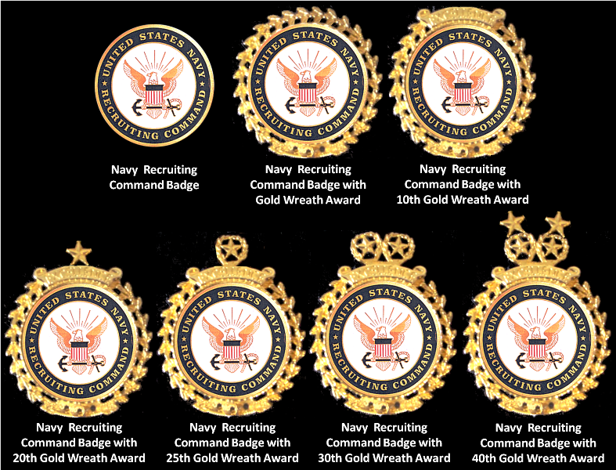
NAVY RECRUITING
Commander, Navy Recruiting Command (CNRC) (Millington, TN)
Region East / Region West (Millington, TN)
Navy Talent Acquisition Groups (26 various locations)
Navy Recruiting Orientation Unit (NORU) (Pensacola, FL)
Recruiting Production
Enlisted – about 2200 new contracts / year
Nuke, NSO/NSW
NAT/TAR
Prior Service now part of NRRC
Officer – about 200 accessions / year (Now AC)
General Officer (SWO, Aviation, Nuke, CEC, Chaplain, etc.)
Medical, Dental, Nurse, and Medical Service Corps
NROTC (SWO, Aviation, and Unrestrictive Line Officers)
Reserve Mission now part of NRRC
NRC Mission: “Leverage an inspirational culture to inform, attract, influence and hire the highest quality candidates from America's diverse talent pool to allow America's Navy to assure mission success and establish the foundation for Sailors to thrive in a life-changing experience”
Notes:
Multiply and manipulate this slide to fit all your text, video and etc. content

Slide 17
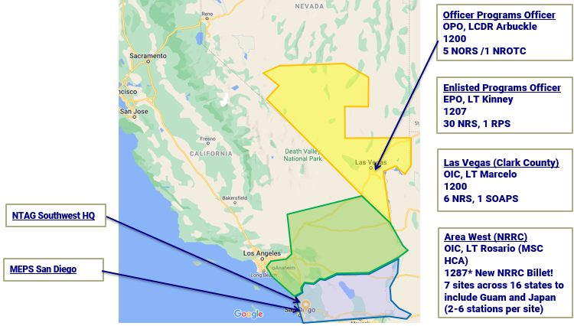
NTAG SW AREA OF RESPONSIBILITY
*Of the 26 NTAG’s, we are the largest in the Nation
Notes:
Multiply and manipulate this slide to fit all your text, video and etc. content

Slide 18
NTAG SW HR BILLET SUMMARY
Billets
CO/XO Fleet up (HB1/CE5 & 9421/9436),
Enlisted & Officer Programs Department Head AQD’s (Officer NEC’s): HD1, RFX & 3020
DH Billet Responsibilities
Manage a team of 200+ Enlisted & 20+ Officer Recruiters, and about 5 civilians and contractors
Handle all administrative and oversee operational tasking, to including weekly enlisted gate briefs and production-related tasking to include:
Station visits/Inspections, Swear-ins, Application Processing Summary Records, Tattoo Waivers, Goal reviews, Coordinate Training, Awards, Incentives, Evals, FITREPs, etc
Organizational structure
DH’s work directly for XO. Work in tandem with an NCCS (Production SME). Supervise 3-4 DIVO’s (O-1 to O-3) and various OHARP’s
Career track and alignment
Force Development, 43010 Recruiting Operations Officer (R-OPS), 43027 Navy Adv. Program Test Admin
Notes:
Multiply and manipulate this slide to fit all your text, video and etc. content

Slide 19
NTAG SW HR BILLET SUMMARY CONTINUED
Strengths Needed and Developed
Leadership, Communication, Organization, Forward-Thinking, Recruiting fundamentals, Civilian Management, Diversity, Sales/Marketing, Conflict Resolution, Motivation etc.
Challenges
Operational Duty, Hard to get everyone together, enlisted rates working out of rate, Communication, “Alone and Unafraid”
Areas of improvement for billet and career track alignment
Better initial ROPS Training, and transitional training for new systems/implementations (Salesforce, Genesis, etc)
Notes:
Multiply and manipulate this slide to fit all your text, video and etc. content

Slide 20
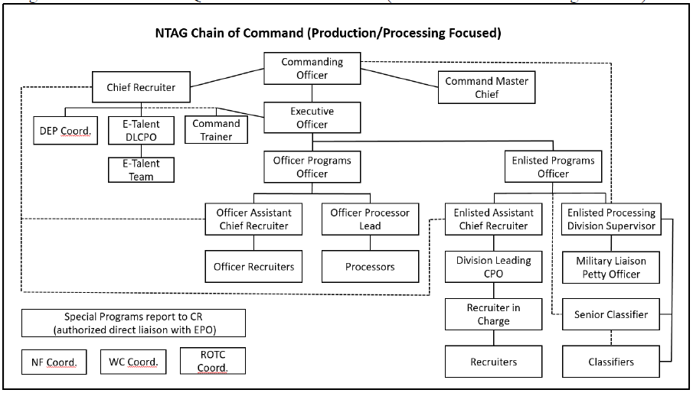
RECRUITING ORGANIZATIONAL BREAKDOWN
*The CRF community provide consistency and expertise throughout the enterprise
Notes:
Multiply and manipulate this slide to fit all your text, video and etc. content

Slide 21
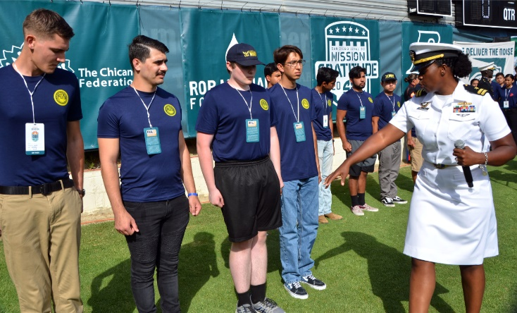
MARKETING
Face of the Navy in the Local Lommunity
Military Events
Local Civil organizations
High Schools / Universities
Speaking Engagements
COMREL Events
Marketing and Advertising Plan
Local Advertising (yard signs, newspapers, professional journals, booths)
LEADS Generation
Market Analysis
School Lists / School Administrators
Notes:
Multiply and manipulate this slide to fit all your text, video and etc. content

Slide 22
CIVILIAN MANAGEMENT
MyBiz+
Mid-term / Annual Appraisals
Developing Critical Elements
Progress Reviews
Hiring
Job Analysis / Advertising / Personnel Selection
Counseling / Awards / Timekeeping
Disciplinary vs. Performance
On the Spot / Annual Awards / Swag
SLDCADA
Notes:
Multiply and manipulate this slide to fit all your text, video and etc. content

Slide 23
MEDICAL PROGRAMS
Health Professional Scholarship Program (HPSP)
Medical, Dental, Medical Service Corps
$10K Annual Tuition
Health Service Collegiate Program (HSCP)
Medical Service Corps, Medical, Dental
Paid as an E-6 (promotion opportunities)
Great for Active Duty personnel
Nurse Candidate Program (NCP)
Financial Assistance Programs
Medical & Dental

Slide 24
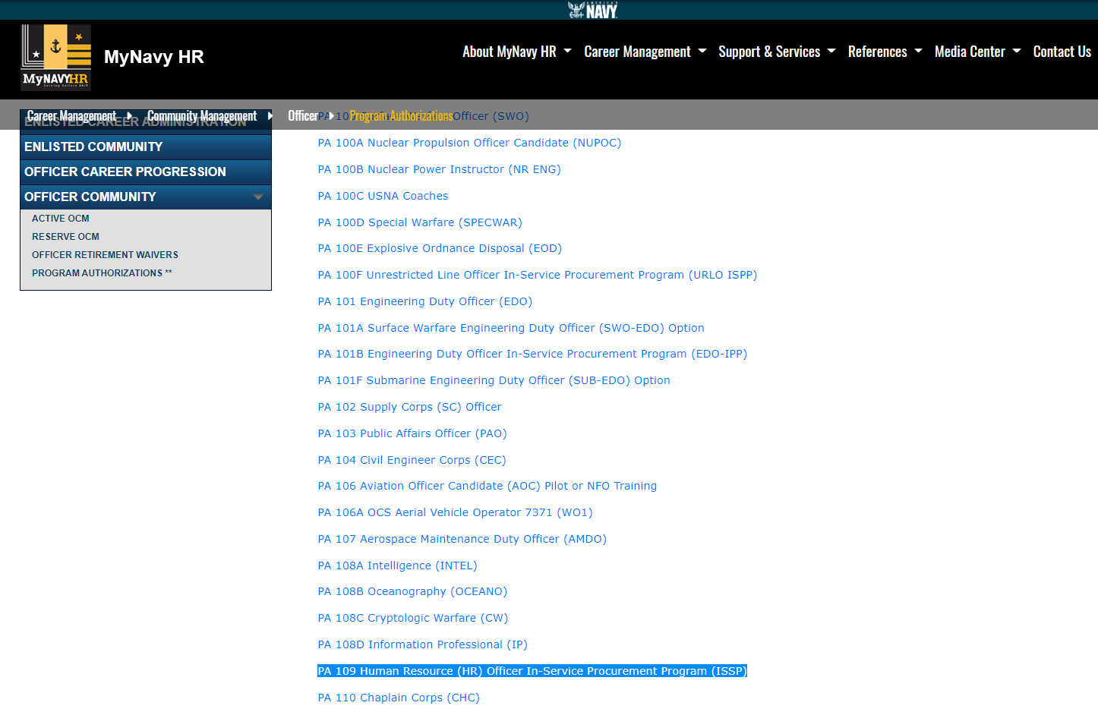
GENOFF AC PROGRAMS
*We give out the ASTB/OAR for the Fleet
Program Authorizations can be found at MYNAVYHR

Slide 25
GENOFF RC DCO PROGRAMS
PA 208B Oceanography (OCEANO)
PA 208C Cryptologic Warfare (CW)
PA 208C Information Professional (IP)
PA 211 Judge Advocate General's (JAG) Corps
PA 232 Aerospace Engineering Duty Officer (AEDO)
PA 230 Human Resources (HR) Officer
PA 100 D Special Warfare Officer (SPECWAR)
PA 201A Engineering Duty Officer (EDO)
PA-202 Supply Corps (SC) Officer
PA 203 Public Affairs Officer (PAO)
PA 204 Civil Engineer Corps (CEC)
PA 207 Aviation Maintenance Duty Officer (AMDO)
PA 208A Intelligence (INTEL)
Program Authorizations can be found at MYNAVYHR

Slide 26
PA 230 Human Resources (HR) Reserve Officer
Applicants must be between 21 to 42 years old at the time of commissioning. Prior qualifying service will be considered year for year up to age 52.
Education: Possess a bachelor or graduate degree from an accredited institution. It is preferred that degrees be in HR related fields.
It is preferred that applicants possess a current, nationally-recognized professional HR certification.
Time in service: Applicants must have served on active duty for a cumulative period of at least 1 year, which may include any combination of active duty orders.
Work Experience: Must have at least 5 years of prior military experience and/or significant civilian occupational experience in human resource management, personnel management, manpower analysis, personnel policy, business management, financial management, strategic planning, risk management, operations/systems analysis, HR information systems management, course/training development or recruiting.

Slide 27
HR Values for Promotion
For O-4 and Above
Sustained Superior Performance
Consistent/Progressive high ranking FITREPS with Hard/Soft Breakouts
HR Certification - HRCI.org
PHR (Professional Human Resources), SPHR, GPHR, CPT, CPLP, CDFM, & CDFM-A
HRCP.org, HRCI.org practice tests, PocketPrep app, NAVYCOOL (Can pay for certs) can help! SHRM doesn’t qualify for the AQD
HR-Related Graduate Degree
HR Management, Business Administration, Operational Analysis, Organizational Leadership etc
HR Community Involvement
AQD’s and Subspecialty codes i.e. TRAINO (3120P) tours etc
BOD (Board of Director) membership and activity, leadership amongst your HR Region
Command Qualification
PQS for those seeking Milestone positions and to be CO of a HR command, i.e. MEPS, NTAG’s, OIC’s etc
JPME (Joint Professional Military Education)
Must be O-3 or above
Notes:
Multiply and manipulate this slide to fit all your text, video and etc. content

Slide 28
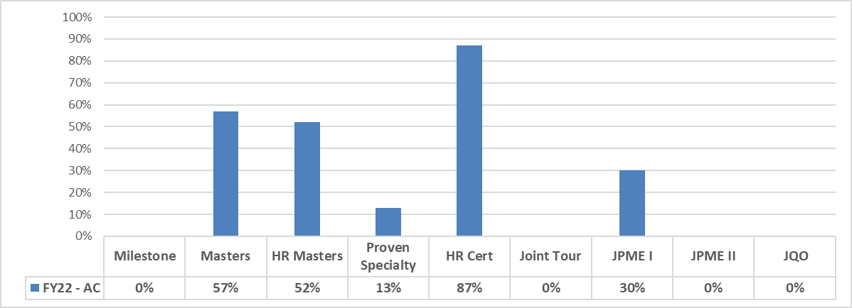
FY22 PROMOTION STATS - LCDR
AC LCDR: Selects averaged 2.3 vs 0.9 Non-select average
Notes:
Note 1: The average in the yellow box reflects the average number of HR Community values held by selects and non-selects. Some values are grouped and count as one (masters and HR masters are grouped, and joint tour, JPME I, JPME II, and JQO are grouped). For CAPT and CDR, there are 6 possible community values. For LCDR, there are 5 possible community values.
Note 2: Milestone percentages reflect officers who completed their Milestone by the date of the promotion board, but not officers who were serving in milestone assignments.

Slide 29
Key Takeaways
Very well written personal statement
Excellent grade point average
Top ranking status on evaluations, are you the EP? Why aren’t you the EP?
A "can do" personality
No court violations or NJP infractions, within three years of application.
Personal awards
Met all program authorization requirements
Demonstrated Sustained Superior Professional Performance
Aptitude to become a Officer; has anyone discussed your potential to become an officer?
Diversity of assignments (Operational, OCONUS, MTF)
Demonstrated positions of leadership, have you had hard jobs?
Strong, authentic command endorsement and compelling interview appraisal sheets

Slide 30
In Summary…
Seek Mentorship (manage your expectations and don’t waste their time)
Want to be an Officer? Start acting like one NOW!
Excel in your Rating Specialty and Aim for the following:
#1 EP
Sailor of the Year
Outstanding PRT’s
Impressive Grades
Military Outstanding Volunteer Service Medal
Senior Letters of Recommendation
Know your References
Always use the most updated PA’s/ALNAV’s and NAVAdmins:
https://www.mynavyhr.navy.mil/References/Messages/
https://www.mynavyhr.navy.mil/Career-Management/Community-Management/Officer/Program-Authorizations/
Research & Network
HR Regional Brown Bag (Lunch and Learns)
Facebook/Linked In Groups
Association of Naval Services Officers: ANSOMIL.ORG
National Naval Officer Association: NNOA.ORG

Slide 31
HRO’s Present for Questions
FTS
CDR Keith Bushey Commanding Officer, NTAG SW, 1207
LCDR Heidi Antonucci Reserve Program Deputy Director, NSW Command, 1207
Active Duty
LCDR Nikita Taylor PXO, TSC SD, 1200
LCDR Twyla Arbuckle Officer Programs Officer, NTAG SW, 1200
LTJG Kali Palomarez Officer Recruiter, NORS Santee, 1200
Reservists
LT Jude Rosario Officer in Charge of Reserve Recruiting, NRRC Area West, 2305
LTJG Marcia Villavicencio NRRC Area West, Direct Commission Officer, 6415
Notes:
Note 1: The average in the yellow box reflects the average number of HR Community values held by selects and non-selects. Some values are grouped and count as one (masters and HR masters are grouped, and joint tour, JPME I, JPME II, and JQO are grouped). For CAPT and CDR, there are 6 possible community values. For LCDR, there are 5 possible community values.
Note 2: Milestone percentages reflect officers who completed their Milestone by the date of the promotion board, but not officers who were serving in milestone assignments.

Slide 32
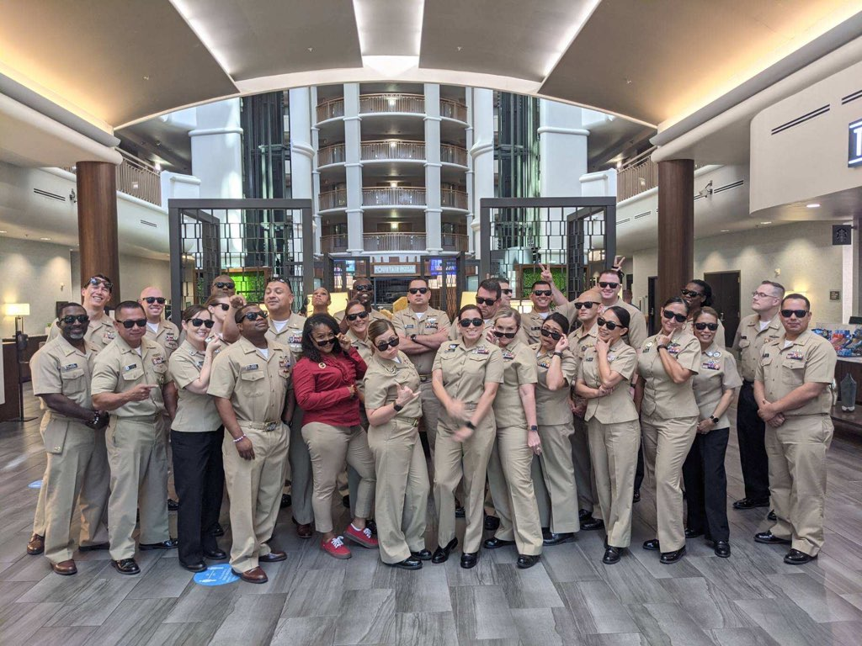
Questions?
Notes:
Ending Slide

Slide 33
Human Resources Officer FY23 AC Merit Reorder Considerations
Sustained superior performance in positions of increased responsibility, complexity, and judgement should be the primary consideration for Merit Reorder.
Valued achievements prior to LIEUTENANT COMMANDER
Top recognized performer in source community and/or subsequent HR tour(s)
Meets one or more HR community competency skill requirements identified in convening order
Professional Certification including PHR, SPHR, GPHR, CPT, CPLP, CDFM, CDFM-A
Completion of Master’s degree in HR related subspecialty including Operations Analysis, Manpower Systems Analysis, Financial Management, Education and Training Management, or civilian equivalent (3210P, 3130P, 3150P, 311XP, 3XXXP)
Command eligible (2D1)
Valued achievements prior to COMMANDER
Top recognized performer across all assignments, especially LCDR HR Command / Leadership / Sea Screened tour (CO/XO/OIC/Sea Duty)
Command eligible or qualified (AQD: 2D1/2D2)
Meets one or more HR community competency skill requirements identified in convening order
Documented depth of experience (3 or more tours) within at least one HR career track (FD, FM, FR2)
HR PROVEN subspecialty (Q/R suffix): (321X, 3130, 3150, 311X)
Valued achievements prior to CAPTAIN
Top recognized performer across all assignments, especially CDR HR Command / Leadership Screen (CO/XO/OIC) tour
Meets one or more HR community competency skill requirements identified in convening order
Documented successful completion of O-6 command eligibility (AQD: RLC)
Fleet N1/TYCOM/HQ/Major staff experience
Documented depth of experience (4 or more tours) within at least one HR career track (FD, FM, FR2)
Diverse HR subspecialty experience, with at least one PROVEN (Q/R suffix): (321X, 3130, 3150, 311X)
JQO

Slide 34
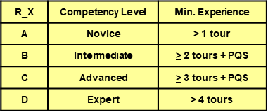
** Active Component HR (1200) only **
Career Track – Framework
Core Competency Areas
Career Tracks
Development
Career Timing
Force Development
Recruiting
New Framework
Force Management
Optimized Career Management
Billet Skills Match
Management
Data- Driven
Force Requirements & Resourcing
Requirements
Qualifications
Performance
EXISTING HR AQDs
CAREER TRACK CODES
RA1-4 | PHR/SPHR/GPHR/CPT | RDX | Development
RB4-6 | HR Milestone | REX | Management
RC4-6 | HR Post-MS | RFX | Recruiting
 |  | RGX | Requirements
New AQDs
CAREER DEVELOPMENT CODES
Retain existing AQDs
CCA AQDs still in use by 1205/1207
Deliberate Competency Development: Deliver the right HR officer in the right place, with the right skills, at the right time

