Slide 1
Originated by LT Darnell “Gov” Harris
Updated and Presented by LT Twyla Arbuckle

Slide 2
Agenda
Welcome!
Introductions & NNOA Mission
General Program Comparisons
Naval Academy
Seaman To Admiral-21
Officer Candidate School
Limited Duty Officer/Chief Warrant Officer
NEW! Aerial Vehicle Operator Warrant PA
Other Direct Commission Paths
Medical Program Comparisons
Medical Enlisted Commissioned Program
Medical Service Corps-In-Service Procurement Program
Nurse Candidate Program
Health Service Collegiate Program
Health Profession Scholarship Program
Summary for Gaining a Commission
Senior Advisor’s Advice on Senior Letters of Recommendations
Commissioning Program & Community Breakout Sessions

Slide 3
(U) General Program Comparison
 | Naval Academy | STA-21 | OCS | CWO | LDO
Designator | URL, RL, Marines, Selected Staff Corps | SWO, SWO/ED, NUC, SPECWAR, EOD, NFO, PILOT, CEC, Nurse, IP, Core | URL, RL, Selected Staff Corps | Surface, Sub/NUC, Aviation, General/ Staff, and IW Communities | Surface, Sub/NUC, Aviation, General/ Staff Communities and Off-Ramp IW & Off Ramp Supply
Max Age/ TIS/TIG | 17-23 on July 1 of the year of entry | Core-27, PILOT/NFO-27 SPECWAR-29, EOD-30, NUC/SWO -31 CEC-35, IP-35, Nurse-42, (Waivers…) | At least 19; meet Program Authorization requirements | CWO2: 14-20 years TIS for E6 selected for E7, E7, and E8 (includes frocked E9s). CWO3: 14-22 years TIS and 1 day TIG as an E9 as of board convening date. LTJG: Case by Case basis | 8-14 years TIS and 1 year TIG for E6 and up. Off-ramp designators (651X, 681X, and 682X) may apply up to 15 years TIS.
Reqs | US Citizen, Nomination, SAT 1050 or 22 ACT within 2yrs | US Citizen, SAT 1000 (500 math 500 reading) or ACT 41 (21 math 20 Eng) | US Citizen, Officer Aptitude Test, Bachelor’s Degree, GPA 2.5 | US Citizen, High school graduate, physically qualified of SAT-Medium or higher, CPO | Same as CWO except E-6 and above. Meet final multiplier for CPO exam.
Disqualifiers | Disciplinary action under Article 15, Civil Court convictions, LIMDU, Married, Pregnant, dependents, obligations of parenthood | Felony convictions, drug use, DUI/DWI-3 years, NJP or misdemeanors-3yrs, courts martial, PFA failure-3yrs, LIMDU, PFA below Good High, Bachelor’s Degree | Courts-martial, civilian felony convictions, NJP/ misdemeanor convictions last 3 years, LIMDU | Felony convictions, drug use, DUI/DWI-3 years, NJP or misdemeanors -3yrs, courts martial.HYT, LIMDU, HUMS, TNPQ, Defective color perception (for certain designators ) NMT 20 years. | Same as CWO. NMT than 16 years of service, CWO’s cannot have 1x Failure to Select, or less than 2 years commissioned service.

Slide 4
General Program Comparison Cont.
 | Naval Academy | STA-21 | OCS | LDO | CWO
Funding | 100% paid tuition, room & board. Monthly stipends | $10K per year ($8k for fall/spring, $2k for summer) | NA | N/A | N/A
Service obligation before/after commission | 24 months upon acceptance/ 5 years | 6 years/5 years (pilot-8 yrs, NFO-6yrs | 6 months upon receipt of orders to OCS/ 4 years | 4 years from commissioning and 10 years to retire as an Officer | 6 years from commissioning
Application Due Date | 31Dec; Additional supplements NLT 31Jan | 1Jul; Additional supplements NLT 1AUG | Year round-see schedule | 01OCT; Routine Addendums received by NPC NLT 01 DEC Evals and Awards received by NPC: NLT 01 JAN | 01OCT; Routine Addendums received by NPC NLT 01 DEC Evals and Awards received by NPC: NLT 01 JAN
Eligible for Advancement | No | Yes | N/A | N/A | N/A

Slide 5
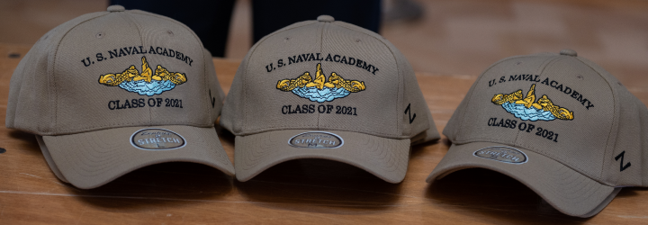
Naval Academy

Slide 6
Naval Academy
Applicant’s Responsibility:
Preliminary Application vis USNA Website
Application request for a SECNAV nomination submitted via COC
CO’s Endorsement
SAT/ACT scores (Must be re-taken if older than 2 yrs) SAT:
(Aim to score above 500 in reading (verbal) and above 550 in math, with a combined minimum of 1050. No recommended score for the writing component, but it may be used for evaluation purposes)
ACT: Scores of at least 22 in English and 24 in Math are recommended
High school transcripts or GED (via mail)
Evals & College Transcript(s) – if applicable. In order to receive credit for an Associates degree, it must be documented on JST or College transcript.
Top performers who need to strengthen their academic background may be selected to attend the Naval Academy Preparatory School (NAPS) in Newport, RI for one year and receive an appointment to USNA the following year.

Slide 7
Selection Board Emphasis
OFFICER POTENTIAL
Fleet performance
Demonstration of Strong Leadership
BJOQ/BJOY/SOQ/SOY
Top 20% of A/C Schools
Community volunteers
Willingness to assume responsibility
Advancement record
Physical fitness
Officer comments
ACADEMIC POTENTIAL
High School Transcript (Ranked in top 40% of class
College Transcript
Joint Service Transcript
SAT/ACT Scores
Continued education since high school is vital

Slide 8
USNA Life
Four Years designed to push you beyond perceived limits
Plebe Summer (8-weeks), Summer Cruises (i.e. PROTRAMID)
More than 100 Extracurriculars
Typical Weekday Schedule:
5:30 a.m. Arise for personal fitness workout (optional)
6:30 a.m. Reveille (all hands out of bed)
6:30 - 7:00 a.m. Special instruction period for plebes
7:00 a.m. Morning meal formation
7:15 a.m. Morning meal
7:55 - 11:45 a.m. Four class periods, 50 minutes each
12:05 p.m. Noon meal formation
12:10 p.m. Noon meal
12:50 - 1:20 p.m. Company training time
1:30 - 3:30 p.m. Fifth and sixth class periods
3:45 - 6:00 p.m. Varsity and intramural athletics, extracurricular and personal activities; drill and parades twice weekly in the fall and spring
6:30 - 7:15 p.m. Evening Meal
8:00 - 11:00 p.m. Study period
Midnight. Taps for all midshipmen

Slide 9
USNA Reference and Contacts
References
ALNAV 077/20 Enlisted Applications to the U.S. Naval Academy
OPNAV 1420.1B Enlisted to Officer Commissioning Programs Application Admin Manual
https://www.usna.edu/Admissions/Apply/Active-Duty-Service-Applicants.php
Contact
Commercial: (410) 293-1839/DSN 281
Email: Bland@usna.edu
Website: http://www.usna.edu/Admissions/Steps-for-Admission/Active-Duty-Service-Applicants.php.

Slide 10
Seaman to Admiral (STA) 21

Slide 11
STA21 Application
Applicant’s Responsibility:
Online Application: www.netc.navy.mil/Commands/Naval-Service-Training-Command/STA-21/
Application cover letter
Personal statement (check for misspelled and improper grammar)
Evals (last 5)
SAT/ACT Due to COVID-19 pandemic impacting SAT/ACT availability an exception to policy is approved. If SAT/ACT test is not available, eligibility will require HS GPA within the last 5 years or college cumulative GPA with more than 12 semester hours and a minimum of 2.5 on a 4.0 scale
ASTB (Pilot or NFO only)
High school transcripts or GED.
College Transcript(s) – if applicable. In order to receive credit for an Associates degree, it must be documented on JST or College transcript.
Ability to complete a 36-month baccalaureate degree prior to target option

Slide 12
STA21 Application Cont.
Applicant’s Responsibility:
Letters of Recommendation from desired community
JST (Joint Service Transcript) no longer required (see FY22 PA)
Additional documents (NEC, qualifications, awards, page 4s, etc.).
PFA/PRT results (last 3 cycles printed from PRIMS with event results) Due to the COVID-19 pandemic impacting physical fitness assessment (PFA) testing, an exception to policy is approved. A Commanding Officer’s statement in the package endorsement is required to ensure the applicant is within height and weight requirements
IP selectees must have a current TS/SCI clearance or provide proof that TS/SCI documentation has been submitted.
Nuclear personnel only – an approved NAVPERS 1306/7 by OPNAV (N133), and detailer (Pers-403), is required for all Nuclear trained personnel with NEC 335X, 336X, 338X and 339X who are applying for non-nuclear Officer commissioning program.
Photograph (Nuclear Only) no longer required (see FY22 PA)
Page 13 Statement of Understanding (for option and CORE (if applicable))

Slide 13
STA-21 Interview Appraisal Board
Command’s Responsibility:
CO Endorsement letter with ranking- signed and dated
CO Recommendation Form
Interview board appraisal sheets (3) – CO does not submit one
Nomination Review Board’s Responsibility:
Chairperson must be senior to CO
NRB Chairperson Recommendation Form
Interview board appraisal sheets (3) – NRB Chair does not submit one
Interview Verification Form – signed and dated by both Commanding Officers
At least one Officer in the desired designator
Appraisal Forms should not be returned to the applicant!
Notes:
CO’s endorsement
If waiver requested, CO should comment on it.
If Command wants you to do rough endorsement, DO IT! And don’t be shy or humble!
If Command doesn’t fulfill their responsibilities, you won’t be penalized. Stay up to date using the application status portion of the web site.
Ensure one rep from chosen option on board. All 03 and above.
In ranking, consider how rank will help or hurt based on comparative group. Will you rank all candidates or like groups of candidates.
Does the CO recommendation match the evaluations recommendations?
Nom boards
must be justified in the CO’s endorsement if not done
Nom Chairman doesn’t have to be senior to CO, but must not be in the chain of command (i.e., not subordinate to the CO)
Chairman can be member of board (1 of 3 or 1 of 4). Ensure designators and job titles are on sheets for 03 or above.

Slide 14
Selection Board Emphasis
OFFICER POTENTIAL
Fleet performance
CO’s Endorsement
Leadership
Willingness to assume responsibility
Advancement record
Officer comments
Physical fitness
Hardships/Unique experiences that shaped character
ACADEMIC POTENTIAL
High School Transcript
College Transcript
SAT/ACT Scores
*Nuclear SWO/Sub Target option for NEC N1XX/N2XX holders
-Must be able to start first day of class prior to commencing their 8th year of service

Slide 15
Post Selection
Officer Candidate-- NROTC Mentor
Naval Science Institute (NSI) OTC Newport (8 weeks)
Introduction, Sea Power and Maritime Affairs
Naval Sea Systems I and II (Engineering and Weapons)
Navigation and Naval Operations
Full-Time Undergraduate Status!
Drill alongside NROTC
Calculus I and II
Calculus based Physics I and II
Maintain 2.5 GPA
Of 339 apps, 318 were board eligible, 55 FY-21 Selected
*FY-22 Non-Qualifier: Not meeting authorized ETP criteria SAT/ACT and PFA
*Time does not count towards officer retirement but it does count for pay purposes.

Slide 16
STA21 Reference and Contact
Reference
NAVADMIN 094/21: FY-21 SEAMAN TO ADMIRAL-21 PROGRAM ANNOUNCEMENT
OPNAV 1420.1B Enlisted to Officer Commissioning Programs Application Admin Manual
Program Authorization (PA) for each community which can be found on the STA-21 website or on MyNavy HR (career management>career counseling>commissioning pro)
www.netc.navy.mil/Commands/Naval-Service-Training-Command/STA-21/
Facebook: Search, “Future Mustang Mentorship” or “Seaman To Admiral-21”
Contact
Commercial: (847) 688-4607 ext 124 DSN 792
Fax: (850) 452-2486 or DSN 459-2486
Email: PNSC_STA21@navy.mil
Website: www.netc.navy.mil/Commands/Naval-Service-Training-Command/STA-21/

Slide 17
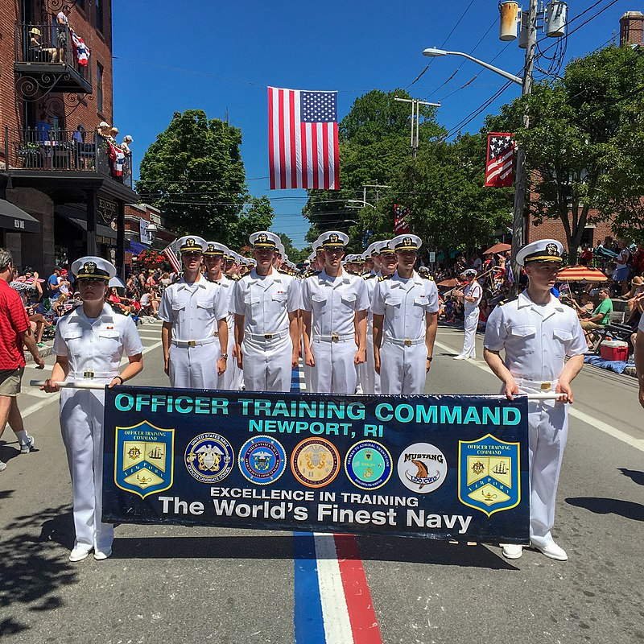
Officer Candidate School (OCS)

Slide 18
Training & Requirements
Requirements
Officer Apptitude Test
See Program Authorizations for age reqs
PT: Min of Sat Med
12 Weeks
Heavy PT
Heavy Drill
Room, locker, personnel inspections
Heavy Memorization
Academic Subject Areas
Programs and Policies, Sea Power, Engineering and Weapons, Damage Control, Naval Orientation and Seamanship, Leadership, Naval Orientation and Warfare, Navigation, Military Law
Male Standards by age: 18-21: 22% 22-29: 23% 30-39: 24% 40+: 26% | Female Standards by age: 18-21: 33% 22-29: 34% 30-39: 35% 40+ 36%

Slide 19
Application

Slide 20
References
References
OCS Board Schedule https://mpte.navy.deps.mil/sites/nrc/n3/n31/Board%20Schedules/Forms/AllItems.aspx Or contact Navy Recruiting Command
OPNAV 1420.1B Enlisted to Officer Commissioning Programs Application Admin Manual
MILPERSMAN 1301-400 IN-SERVICE PROCUREMENT PROGRAMS
https://www.mynavyhr.navy.mil/Career-Management/Career-Counseling/Commissioning-Programs/
Contacts:
Email: OTC_Admin@navy.mil

Slide 21
LDO & CWO

Slide 22
LDO/CWO Updates
Read the announcing NAVADMIN, Discrete Requirements and Chapters 2, 7, and Appendix F of OPNAVINST 1420.1B
Where conflicts exist, follow the NAVADMIN
FY23 eligibility
LDO ENS: E6 to E9 with 8-14 years time in service
E6 applicants must have 1 year TIR as of 1 October of calendar year of application (1 Oct for FY22 board) and pass the E7 exam
CWO: E7 to E8 with 14-20 years time in service, E9 with 14-22 years
CWO to LTJG: 14-16 years time in service and 2 years time in grade
Additional requirements
U.S. Citizenship, High school graduate or GED
Color vision test (for certain designators)
No NJP/civil conviction in the last three years as of 1 October of calendar year of application (1 Oct 16 for FY21 board)
Documented Technical & Leadership Experience

Slide 23
Notes:
CO’s endorsement
If waiver requested, CO should comment on it.
If Command wants you to do rough endorsement, DO IT! And don’t be shy or humble!
If Command doesn’t fulfill their responsibilities, you won’t be penalized. Stay up to date using the application status portion of the web site.
Ensure one rep from chosen option on board. All 03 and above.
In ranking, consider how rank will help or hurt based on comparative group. Will you rank all candidates or like groups of candidates.
Does the CO recommendation match the evaluations recommendations?
Nom boards
must be justified in the CO’s endorsement if not done
Nom Chairman doesn’t have to be senior to CO, but must not be in the chain of command (i.e., not subordinate to the CO)
Chairman can be member of board (1 of 3 or 1 of 4). Ensure designators and job titles are on sheets for 03 or above.

Slide 24
LDO/CWO Timeline
MAR: Special Request to CO via Command Coordinator
MAY: Submit application to Admin
JUN: Interviewer Appraisal Board
JUL: CO’s endorsement prepared
SEP: Email applications
NLT 01 OCT: Applications due to NPC
NLT 15 DEC: Addendums (Evals, Awards etc.) due to NPC
JAN: Board convenes
MAR: Results announced via NAVADMIN

Slide 25
LDO/CWO FACTS
FY22 Active Duty Selections:
Total Applications: 2,404
Eligible: 2,203
Selected to LDO: 272, 18%
Selected to CWO: 231, 26%
The Competition:
31-35 yrs old w/ 12-17 yrs active service and 15 yrs of education
3-5 Duty Stations, 2-3 Sea/Overseas tours, 7-16% IA/GSA Tours
98% Warfare Qualified
The selection board only considered items in my OMPF, ESR, PSR, and items in my application and any addendums.
Only adverse information contained in my OMPF can be considered by the board.

Slide 26
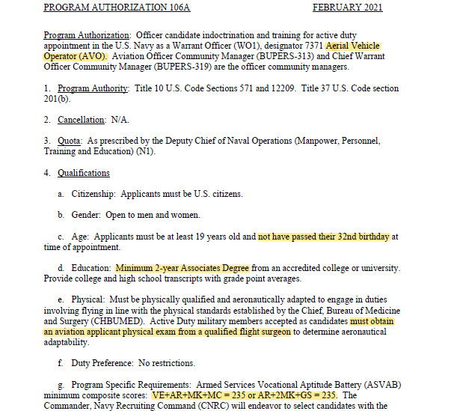
Aerial Vehicle Operator (7371- WO1)

Slide 27
LDO/CWO References
References:
FY 22 Active Duty LDO/CWO ISPB NAVADMIN 161/20: Cyber Warrant Officer Program NAVADMIN 140/18:
NPC Website https://www.mynavyhr.navy.mil/Career-Management/CommunityManagement/Officer/Active-OCM/LDO-CWO
Facebook: Search, “LDO/CWO Community Managers Forum”
For application and eligibility questions, contact:
LT Bryan Gill, Assistant LDO/CWO Community Manager email: bryan.j.gill@navy.mil
LDO/CWO OCM Mailbox: ldocwoocm.fct@navy.mil

Slide 28
Direct Commission Officer

Slide 29
Direct Commission Officer (Reserves & DA)
Must be a U.S. Citizen
Competitive Evals/FITREP’s
Advanced degrees preferred
Enlisted Sailors need a Conditional Release
IWC rates – 4 endorsements required before PERS approval
Highlighted in resume:
Quantitative and Qualitative analysis
Strong Leadership (At work and/or in community)
Certifications
Will need:
Strong Recommendations, Interview Appraisals–- use the New Form!
Motivational Statement
Navy Talent Acquisition Group South West POC’s:
General DCO: LT Cecilia Mitchell at Cecilia.Mitchell@navy.mil, 619-200-8197
Medical DCO: CDR Abreail Leoncio at Abreail.Leoncio@navy.mil, (858) 248-5258

Slide 30
Medical Commissioning Programs

Slide 31
Enlisted Medical Programs Comparison
 | MECP | MSC-IPP | EMDP2
Designators |  | Health Care Administration (HCA), Entomology, Environmental Health, Industrial Hygiene, Medical Laboratory Science, Pharmacy, Radiation Health, Social Work and Physician Assistant. | The Enlisted to Medical Degree Preparatory Program is a 2-year program for Sailors to complete prep coursework for applying for Medical School.
Max Age | 42 (No Age Waivers) | 42 (No Age Waivers) | 42 (No Age Waivers)
Requirements | All ranks, 30 hrs credit accepted towards BSN, 2.5 GPA, SAT 1000, ACT 42. No Felony convictions, drug use, DUI/DWI-3 years, misdemeanors-4yrs, courts martial | E4-E9, SAT 1000: ACT 42 (within 5 yrs) GRE 300, GMAT 525 (See FAQ for specifics) No Felony convictions, drug use, DUI/DWI-3 years, misdemeanors-3yrs, courts martial, PFA failure-3yrs, LIMDU Include a Conditional Release in application | US Citizen, Bachelor’s Degree, 1 semester of college algebra, GPA of 3.2, SAT of 600 in each category or ACT of 28. Endorsed by ECM. PRT of at least “Good” and no more than 2 failures in 4 years. No Felony convictions, drug use, DUI/DWI-3 years, misdemeanors-4yrs, courts martial
Funding | GI Bill, VEAP, Self-funded while being paid full Active Duty benefits | GI Bill, VEAP, Self-funded while being paid full Active Duty benefits | PCS orders are provided to USUHS. All school materials are 100% Funded

Slide 32
Enlisted Medical Program Comparison
 | MECP | MSC-IPP | EMDP2
Service obligation before/after commission | 6 years/8 years | 10 years (8 years with waiver) | 5 years but not guaranteed a commission, must apply to Uniformed Services University of Health Services upon completion
Eligible for advancement | Yes | Yes | Yes
Application Due Date | *1Sep; documentation NLT 15Sep | 1Sep; documentation NLT *15Sep | 1Nov; No additional documents can be submitted after deadline
Reference | NAVADMIN 095/20 https://www.med.navy.mil/sites/nmpdc/professional-development/SitePages/Enlisted%20Commissioning%20Programs.aspx FB Search: MECP University | NAVADMIN 094/20 https://www.med.navy.mil/sites/nmpdc/professional-development/SiteAssets/SitePages/Medical%20Service%20Corps%20Program%20MSCIPP-PA/MSC%20IPP%20NAVADMIN%20094%2020.pdf FB Search: MSC IPP Mentorship | NAVADMIN 263/20* https://www.mynavyhr.navy.mil/Portals/55/Messages/NAVADMIN/NAV2020/NAV20263.txt FB Search: EMDP2 at USU
POC | LT Anthony Waite anthony.s.waite2.mil@mail.mil Ms. Beverly Kemp (301) 319- 4520 | LT Julius Wiseman julius.c.wiseman1@navy.mil 619-985-3798 | HMCS John W. Huckleberry II John.w.huckleberry.mil@mail.mil (703) 681-8274

Slide 33
Medical Programs Comparison
 | Nurse Candidate Program | Health Services Collegiate Program | Health Professional Scholarship Program
Designators |  | Health Care Administration, Environmental Health, Industrial Hyg, Physician Asst., Social Work, Entomology, and Med. Tech/Med. Lab Scientist, Audiology, Physical Therapy, Pharmacy, Dental Service Corps, Medical Service Corps | Medical Physician, Dentist, Optometrist, Physician assistant or Clinical psychologist,
Max Age | 42 (No Age Waivers) | 42 (No Age Waivers) | 42 (No Age Waivers)
Requirements | US Citizen, enrolled in their sophomore or higher year of an accredited educational program resulting in a BSN within 24 months of starting the program.. Physically qualified as a Commissioned Officer. 3.0 GPA; Conditional Release reqd. | US Citizen, enrolled in or accepted to an accredited college/university/ school of study for a designated health profession. Physically qualified as a Commissioned Officer. 3.0 GPA | US Citizen, enrolled in or accepted to an accredited college/university/ school of study for a designated health profession. Physically qualified as a Commissioned Officer. 3.0 GPA
Funding | Initial grant of $10,000 plus $1000 a month for up to 24 months | GI Bill, Self-funded but receive Office Candidate First Class (OC1) Pay and benefits | $20K signing bonus, 100% Paid tuition, $2,330 monthly stipend. School materials reimbursement, Active Duty pay/benefits for 45 days a year
Service obligation before/after commission | 1 to 12 months of scholarship results in a 4 year obligation. 13-24 months = 5 years | 3 years for any 1, 2, or 3 year program (4 year program will have 4 year obligation) | Varies on program but generally agree to serve on Active Duty for 4 years upon completion of school.

Slide 34
Medical Program Comparison Cont.
 | Nurse Candidate Program | HSCP | HPSP
Eligible for advancement | N/A | Yes (If you assist in recruiting another HSCP candidate) | N/A
Application Due Date | 1JUL to 1SEP. Results come out NOV/DEC timeframe. | Rolling Boards every month-- varying on Program (Good to apply at the beginning of the FY) | Rolling Boards every month-- varying on Program (Good to apply at the beginning of the FY)
Reference | https://www.med.navy.mil/Pages/InfoViewPage.aspx?ItemID=24 FB Search: US Navy Nurse & NNCA | https://www.navy.com/sites/default/files/2018-03/mof-financial-brochure.pdf FB Search: NAVY HSCP | https://www.med.navy.mil/SiteCollectionDocuments/HPSP%20FAQ%20Booklet.pdf FB Search: Navy HPSP Students and Physicians
POC | CDR Abreail Leoncio Abreail.Leoncio@navy.mil (858) 248-5258 Navy Medical Officer Recruiter NRD SD – HQ | HMCS Kleinne Lapid Kleinne.V.Lapid@navy.mil 619 882 3709 Navy Medical Officer Recruiter NRD SD - NMCSD | HMC Carla Burkholder carla.burkholder1@navy.mil 619-988-2168 Navy Medical Officer Recruiter NRD SD - NMCSD

Slide 35
Common Characteristics of Selected Medical Applicants
Met all program requirements
Demonstrated Sustained Superior Professional Performance
Aptitude to become a NC officer; has anyone discussed your potential to become an officer?
Diversity of assignments (Operational, OCONUS, MTF)
Demonstrated positions of leadership, have you had hard jobs?
Strong, authentic command endorsement and compelling interview appraisal sheets
Very well written personal statement
Excellent grade point average
Competitive GRE/GMAT ACT/SAT test scores
Top ranking status on evaluations, are you the EP? Why aren’t you the EP?
A "can do" personality
No court violations or NJP infractions, within three years of application.
Personal awards

Slide 36
In Summary...
Seek Mentorship
Want to be an Officer? Start acting like one NOW
Excel in your Rating Specialty and Aim for the following:
#1 EP
Sailor of the Year
Outstanding PRT’s
Senior Letters of Recommendation
Military Outstanding Volunteer Service Medal
Know your References
Always use the most updated PA’s/ALNAV’s and NAVAdmins:
https://www.mynavyhr.navy.mil/References/Messages/
https://www.mynavyhr.navy.mil/Career-Management/Community-Management/Officer/Program-Authorizations/
Research & Network with those in desired community i.e:
Facebook/Linked In Groups
Surface Navy Association: NAVYSNA.ORG
Navy Nurse Association: NNCA.ORG
Association of Naval Services Officers: ANSOMIL.ORG
National Naval Officer Association: SDNNOA.ORG

Slide 37
For More information about the San Diego National Naval Officers Association, Please visit our Website
SDNNOA.ORG

